Slide 1
Identifying Fake and Real News
Capstone project -2 final presentation
By : Muluemebet Ayalew
Sept, 2020

Slide 2
Outline
Background
Data:
Source:
Size:
Data exploration
Data cleaning and preprocessing
Statistical testing
Modeling and validation
Conclusion
Recommendation for feature experiment

Slide 3
Background
Objective: to identify fake and real news based on its content using machine learning techniques.
Significance:
helps news agencies to identify fake news, to falsify it, broadcast the truth and play a role for society.
reduce/avoid confusion, wrong decision, misinterpretation and wrong judgment coming as a result of fake news.

Slide 4
Data Info
Source: from Kaggle in two ‘.csv’ files; fake and true news.
(https://www.kaggle.com/clmentbisaillon/fake-and-real-news-dataset)
Size:
Fake news: 23,481 X 4
True news: 21,417 X4
Columns: news title, text, subject and date(at which the article was posted)
Rows: unique news articles

Slide 5
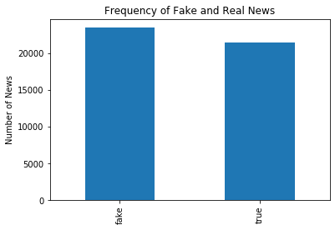
Exploratory Data Analysis
Frequency distribution of fake and true news

Slide 6
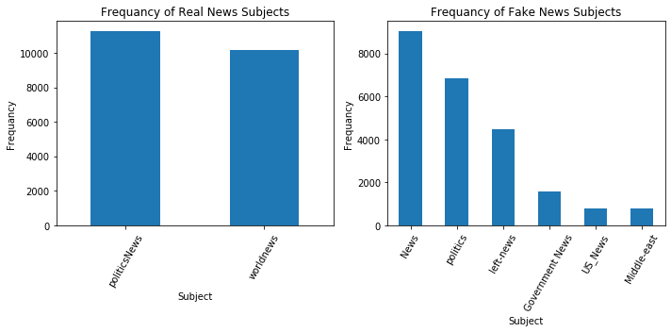
Exploratory Data Analysis: News subject
Fake news has six types of subjects
True news has two subjects of politics news and world news.

Slide 7
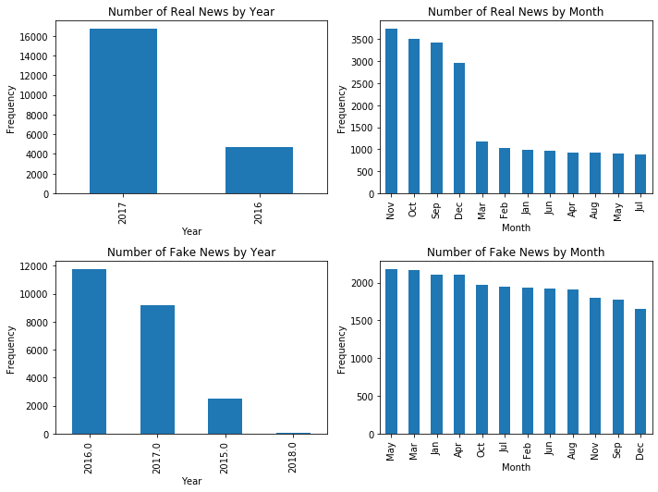
Exploring year/month
Fake: 2015 - 2018
True: 2016 - 2017
Larger true news in Sept., Oct., Nov., and Dec.,

Slide 8
Exploring patterns on the title and the text
Table : Number of news with the specified patterns
Pattern | Fake news |  | True news
 | Title | Text | Title | Text
Emoji | 1 | 0 | 0 | 3(➡️, ☑️, 'ツ')
Url | 9 | 3356 | 0 | 41
Tag((#,@,&) | 862 | 7682 | 25 | 1171
Html | 0 | 79 | 0 | 8
Empty (no text) | 0 | 626 | 0 | 1
Digit | 3008 | 18945 | 1799 | 17309

Slide 9
Input data
Fake data
True data
Data cleaning and preparation steps
Label & concatenate
Remove patterns(emoji, html, url, punctuations, numbers) & stopwords
Tokenization & phrase detection
To model using word count and tfidf
Data cleaning and preparation
Using pre-trained BERT model
Word embedding(word2vec)
Compute mean vectors for each news
Test data
Training data
Training data
Test data
Fine-tune BERT model
Modeling
Modeling and testing
Test data from Snopes
Validation

Slide 10
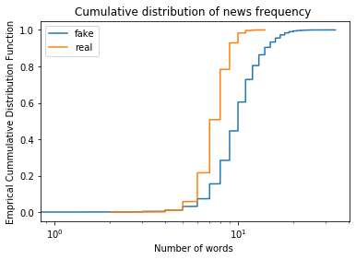
Statistical Test
While exploring the length of the news title after data cleaning, we found that fake news is longer than that of real news
Is this statistically significant?

Slide 11
Steps to make bootstrapped hypothesis test
Step 1: Formulate the hypothesis
The null hypothesis: The titles of fake and real news have the same word length.
Alternative hypothesis: Real news title has shorter word length.
Step 2: Set significance level = 0.05 (5%)

Slide 12
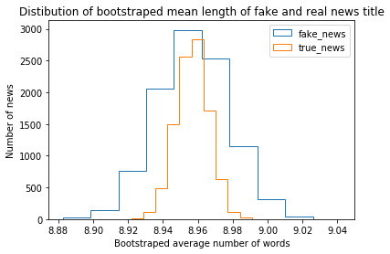
Statistical test
Step 3: Shift the two groups by their merged mean length to get the same mean for each group
Step 4: Get bootstrap replicates (average number of words) of shifted data sets from 10,000 bootstrap samples

Slide 13
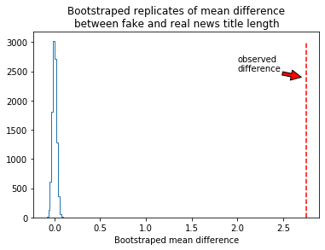
Statistical test
Step 5: Compute bootstrapped mean difference (tests statistics)
Step 6: Compute the p-value=0
(probability the mean difference is greater than the observed difference)

Slide 14
Statistical test: Conclusion
Step 7: Interpretation
p- value (0.0) < significance level (0.05)
The mean length of fake news titles is statistically different from the mean length of real news titles.
-Conclude that on average fake news titles are longer than real news titles.

Slide 15
Models and their performance
Type of Models |  |  | Machine learning method
Data preparation | Predictor | Vectorizer | Multinomial Naive Bayes | Logistic Regression
Not cleaned | Title | Word count | 0.938 | 0.946
 |  | Tfidf | 0.934 | 0.941
 | Text | Word count | 0.950 | 0.996
 |  | Tfidf | 0.937 | 0.984
Cleaned | Title | Word count | 0.937 | 0.944
 |  | Tfidf | 0.934 | 0.938
 | Text | Word count | 0.949 | 0.983
 |  | Tfidf | 0.944 | 0.978
Word2Vec | Title | Mean vectors | - | 0.935
 | Text | Mean vectors | - | 0.976

Slide 16
BERT Model performance for test data
Bert pre-trained model was fine-tune with the following parameters:
Batch size= 16
Learning rate= 2e-5
Epotch =4
precision recall f1-score support
true 0.99 0.98 0.98 2141
fake 0.98 0.99 0.99 2349
accuracy 0.98 4490
macro avg 0.98 0.98 0.98 4490
weighted avg 0.98 0.9 8 0.98 4490

Slide 17
Model summary
The non-cleaned data performed better than the cleaned data. The non- cleaned data may contain some pattern that can indicate the news labels (fake or true).
prediction on text outperformed that of title
word counts better than tfidf.
logistic regression models better multinomial naive bayes.
models based on feature vectors computed from word embedding had close but lower performance than the other models.
BERT model has better accuracy(+ 5%) than other models based on the title on the news

Slide 18
Testing using external data
Using archived news from Snopes; a fact-checking website
https://www.snopes.com/?s=2017+archive+news
https://www.snopes.com/?s=2016+archived+true+news https://www.snopes.com/?s=2017%20archived%20true%20news&hPP=10&idx=wp_live_searchable_posts&page=1&is_v=1
Older news(searched by 2017, 2016)
20 news title and their rating by Snopes extracted (half Fake the other half true news)

Slide 19
Extracted archived news titles
News ID | News Title
1 | Is This James Earl Jones Dressed as Darth Vader
2 | David Rockefeller's Sixth Heart Transplant Successful at Age 99
3 | Did Bloomington Police Discover Over 200 Penises During Raid at a Mortician's Home?
4 | Is the Trump Administration Price Gouging Puerto Rico Evacuees and Seizing Passports?
5 | 2017 Tainted Halloween Candy Reports 11/5/2014
6 | Did President Trump Say Pedophiles Will Get the Death Penalty?
7 | Michelle Obama Never Placed Her Hand Over Her Heart During the National Anthem?
8 | Katy Perry Reveals Penchant for Cannibalism?
9 | Is a Virginia Church Ripping Out an 'Offensive' George Washington Plaque?
10 | Were Scientists Caught Tampering with Raw Data to Exaggerate Sea Level Rise?
11 | Did Trump Retweet a Cartoon of a Train Hitting a CNN Reporter?
12 | Did Pipe-Bombing Suspect Cesar Sayoc Attend Donald Trump Rallies?
13 | Did President Trump’s Grandfather Beg the Government of Bavaria Not to Deport Him?
14 | Did Gun Violence Kill More People in U.S. in 9 Weeks than U.S. Combatants Died on D-Day?
15 | Did the Florida Shooter’s Instagram Profile Picture Feature a ‘MAGA’ Hat?
16 | Wisconsin Department of Natural Resources Removes References to ‘Climate’ from Web Site
17 | Hillary Clinton Referenced RFK Assassination as Reason to Continue 2008 Campaign
18 | Did Richard Nixon Write a Letter Predicting Donald Trump’s Success in Politics?
19 | Did a Twitter User Jeopardize Her NASA Internship by Insulting a Member of the National Space Council?
20 | Did WaPo Headline Call IS Leader al-Baghdadi an ‘Austere Religious Scholar’?

Slide 20
Prediction and accuracy of the archived data(misclassification highlighted in yellow)
 |  | Model Type
 |  | Logistic Regression |  |  |  | Multinomial Naïve Bayes |  |  |  | Logistic Regresion |  | BERT
 |  | Title predictor |  | Text predictor |  | Title predictor |  | Text predictor |  | Title Predictor | Text Predictor | Title Predictor
News ID | Rate by Snopes | Word Count | Tfidf | Word Count | Tfidf | Word Count | Tfidf | Word Count | Tfidf | Word2vec | Word2vec
1 | fake | fake | fake | fake | fake | fake | fake | fake | fake | fake | fake | fake
2 | fake | fake | fake | fake | fake | fake | fake | fake | fake | fake | TRUE | TRUE
3 | fake | TRUE | TRUE | fake | fake | TRUE | TRUE | fake | fake | TRUE | TRUE | fake
4 | fake | TRUE | TRUE | fake | fake | TRUE | TRUE | TRUE | TRUE | TRUE | TRUE | fake
5 | fake | TRUE | TRUE | fake | fake | fake | fake | fake | fake | fake | fake | fake
6 | mixed | fake | fake | fake | fake | fake | fake | fake | fake | fake | fake | fake
7 | fake | fake | fake | fake | fake | fake | fake | fake | fake | fake | fake | fake
8 | fake | fake | fake | fake | fake | fake | fake | fake | fake | fake | fake | fake
9 | Mostly false | TRUE | fake | fake | fake | fake | fake | fake | fake | fake | fake | fake
10 | fake | fake | fake | fake | fake | fake | fake | fake | fake | TRUE | fake | fake
11 | TRUE | fake | fake | fake | fake | fake | fake | fake | fake | fake | fake | fake
12 | TRUE | TRUE | fake | fake | fake | fake | TRUE | fake | fake | fake | TRUE | fake
13 | TRUE | fake | fake | fake | fake | TRUE | TRUE | fake | fake | fake | TRUE | fake
14 | TRUE | fake | fake | fake | fake | fake | fake | fake | fake | TRUE | TRUE | fake
15 | TRUE | fake | fake | fake | fake | fake | fake | fake | fake | fake | fake | fake
16 | TRUE | TRUE | TRUE | fake | fake | TRUE | TRUE | TRUE | TRUE | TRUE | fake | TRUE
17 | TRUE | fake | fake | fake | fake | fake | fake | fake | fake | fake | fake | TRUE
18 | TRUE | fake | fake | fake | fake | fake | fake | fake | fake | fake | TRUE | fake
19 | TRUE | fake | fake | fake | fake | fake | fake | fake | fake | TRUE | fake | fake
20 | TRUE | TRUE | TRUE | fake | fake | fake | fake | TRUE | TRUE | fake | fake | fake
Accuracy |  | 0.45 | 0.45 | 0.5 | 0.5 | 0.5 | 0.55 | 0.55 | 0.55 | 0.5 | 0.55 | 0.55

Slide 21
Conclusion
Given the limited number of the testing data from Snopes, the conclusion about model performance is not the same as that of split test data in all the case. Here, Naïve Bayes models had relatively higher accuracy than that of logistic regression.
The models trained on the basis of the news text still have better accuracy than models trained on the title of the news.

Slide 22
Recommendation for feature experiment
Further recommended experiment :
using pre-trained word embedding models (using spacy or gensim libraries),
using a different word embedding techniques such as doc2vec, skip gram (other type of word2vec), Fast Text, or GloVe.
Fine-tune BERT model using news text
Validate with mode data from Snopes or other news sources.

